Slide 1
FINAL Project 2014
Robert Martí – Joan Martí

Slide 2
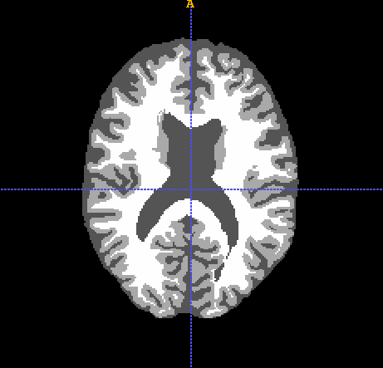
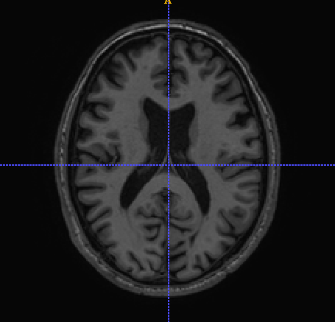
Final Project. Challenge!
Image segmentation contest.
Brain segmentation challenge
Choose your own implementation
Free platform: Matlab, Mevislab or ITK
Based on the MICCAI 2013 MRBrainS challenge,
Images from University Medical Center Utrecht
Evaluaton Criteria
Accuracy
Robustness
Methodology
Computational time

Slide 3
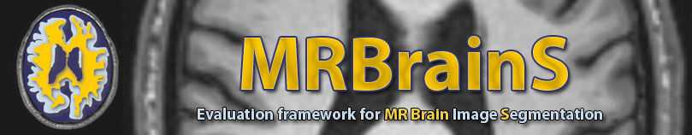
Final Project
Data:
3 patients with T1 and T2 Flair MRI volumes (Nifti format).
For each patient we have original images and an annotated ground truth (LabelsforTesting.nii).
Aim
Segment the 3 cases into 3 different classes and provide the Dice similarity coefficient compared to the ground truth for each class. The classes are:
White matter
Grey Matter
Cerebrospinal fluid (CSF)
You can use the same dataset for training your algorithm (if needed), but do not use the same patient for train & test!
More info: see Readme_forMIA.txt file.

Slide 4
Final Project
Supervision and follow up
Wednesday 30th April 10:00- 12:00 (Lecture)
Wednesday 7th May 10:00 – 12:00 (Lecture)
Submission deadline
14th May: program and oral presentations.
21nd May: report
Submission
Groups of 3 students
Report (pdf) 8 pages max, written in latex, paper format with
Your approach to solve the segmentation problem with references.
Quantitative and Qualitative results
Other aspects such as the problems experienced and the discussion of the results
Presentation (ppt, odps)
Code and executable (source files needed to compile).

Slide 5
Final Project. Evaluation
Good coding practice 10%
Correct and clear programming, use of functions/objects, templates, etc and consistent code and comments.
Methodology 25%
Methods used are well justified, sound and clear.
Know the limitations (when does it fail).
Evaluation and results 20%
Accuracy. Sensitivity and specificity. Dice Similarity coefficient
Computational time
Oral presentation 25%
Report 20%

Slide 6
Final Project
Matlab Files
sevaluate.m. Matlab file for segmentation evaluation (Jaccard index and DSC)
View3d.m. Matlab for visualization of 3D images, else use itk-snap.
testEvaluation. Sample file on how to use the above files and obtain the segmentation results.
NIfTI_20140122.zip For reading nifti files (put them in Matlab path)
ITK
ITK supports reading and writing of nifti files.
Filter to compute DSC: itk::SimilarityIndexImageFilter
Latex
Paper09.zip: tex and style file for the report in latex.

